Slide 1
Elite Master Program
MSc Data Science
LMU München

Slide 2
Data Science@LMU
Spokespersons
Prof. Dr. Göran Kauermann (Statistics)
Prof. Dr. Thomas Seidl (Informatics)
Vice-Spokesperson
Prof. Dr. Matthias Schubert (Informatics)
Coordinators & Contact
Dr. Constanze H. Schmaling / Dr. Michael Windmann

Slide 3
Data Science: What is it about?
Data Science combines informatics and statistics in order to extract information from real data.
“Data Science is a blend of
Red-Bull-fuelled hacking and espresso-inspired statistics”
(Mike Driscoll, CEO Metamarket)
Notes:
Definition von Data Science

Slide 4
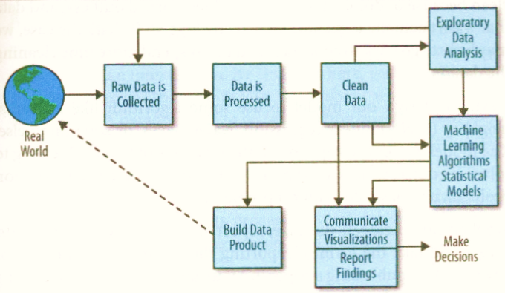
Data Scientists: What do they do?
Source: C. O‘Neil, R. Schutt (2014), Doing Data Science, O‘Reilly Media Inc., USA.

Slide 5
Data Scientists: What do they do?
Apply machine
learning tools
Retrieve
information
from data
Use statistical
models
Deal with data
confidentiality
Communicate
the results
Source: C. O‘Neil, R. Schutt (2014), Doing Data Science, O‘Reilly Media Inc., USA.

Slide 6
Statistics and Data Science
Statistics
1900
Computer Science
1950
Data Science
2000

Slide 7
Why Data Science? Why LMU?
Data Science is ”data driven problem solving“
Data Scientists are needed in industry, business, and science
Data Science requires computational as well as statistical knowledge and skills
At LMU Munich, Statistics and Informatics are in the same faculty

Slide 8
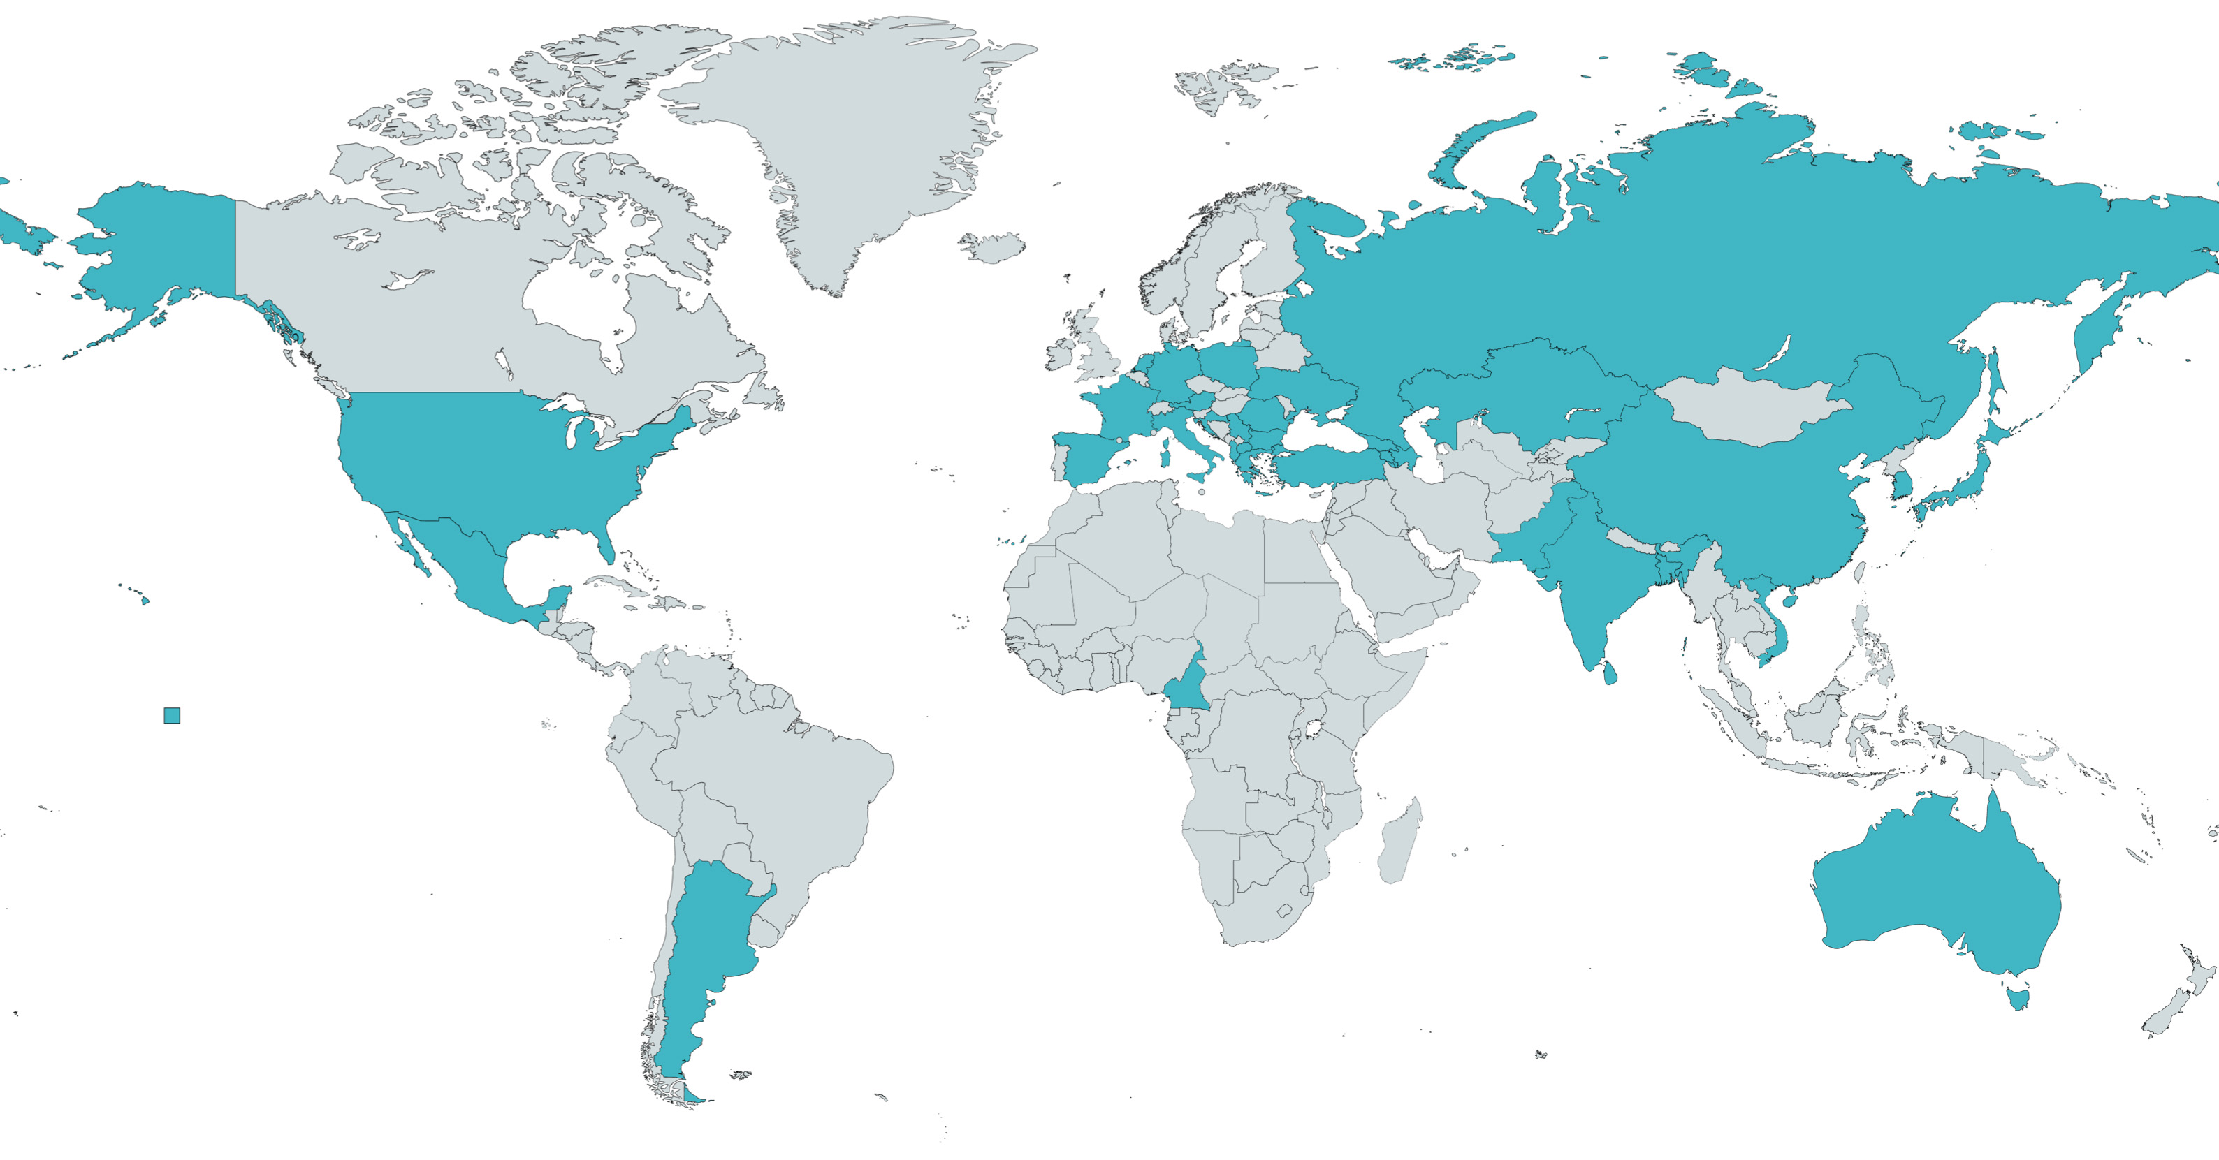

MSc Data Science@LMU
Since winter semester 2016/17
One of the first international
Data Science programs
Supported by the Elite Network of Bavaria
Small cohorts – individual support

Slide 9
Curriculum

Slide 10
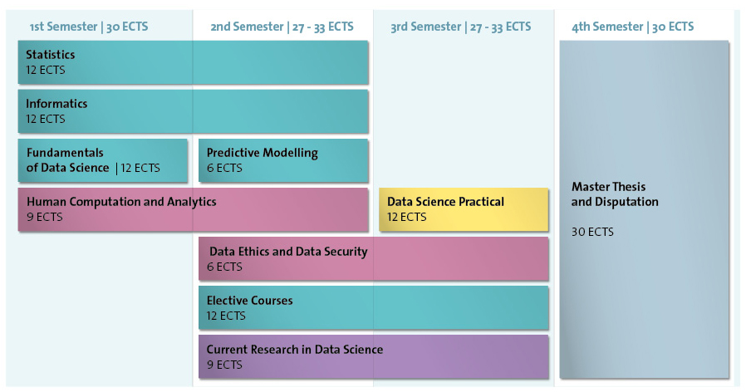

Slide 11
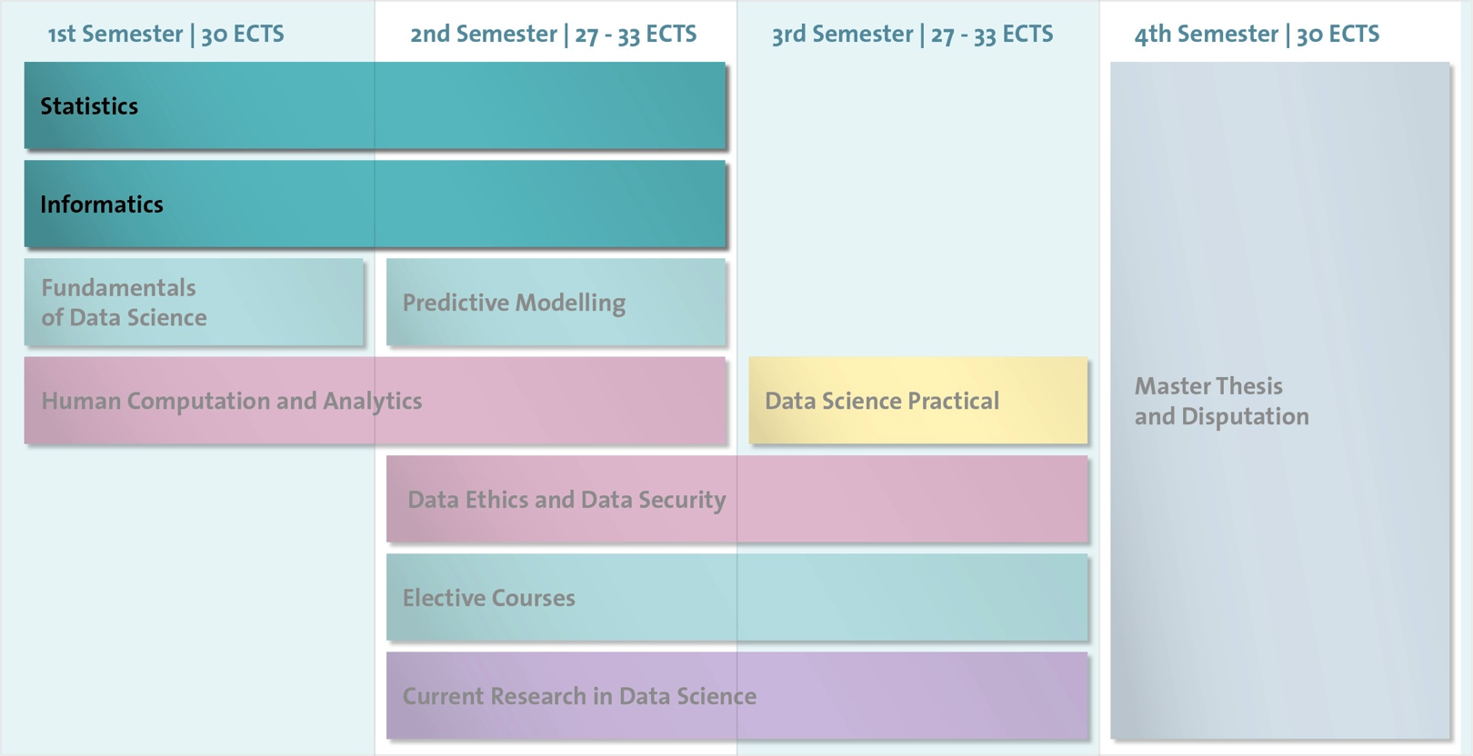

Slide 12
Core Module: Statistics
Statistical Reasoning and Inference (Foundations)
Statistical Reasoning and Inference (Advanced level)
Core Module: Informatics
Knowledge Discovery and Data Mining
Big Data Management

Slide 13
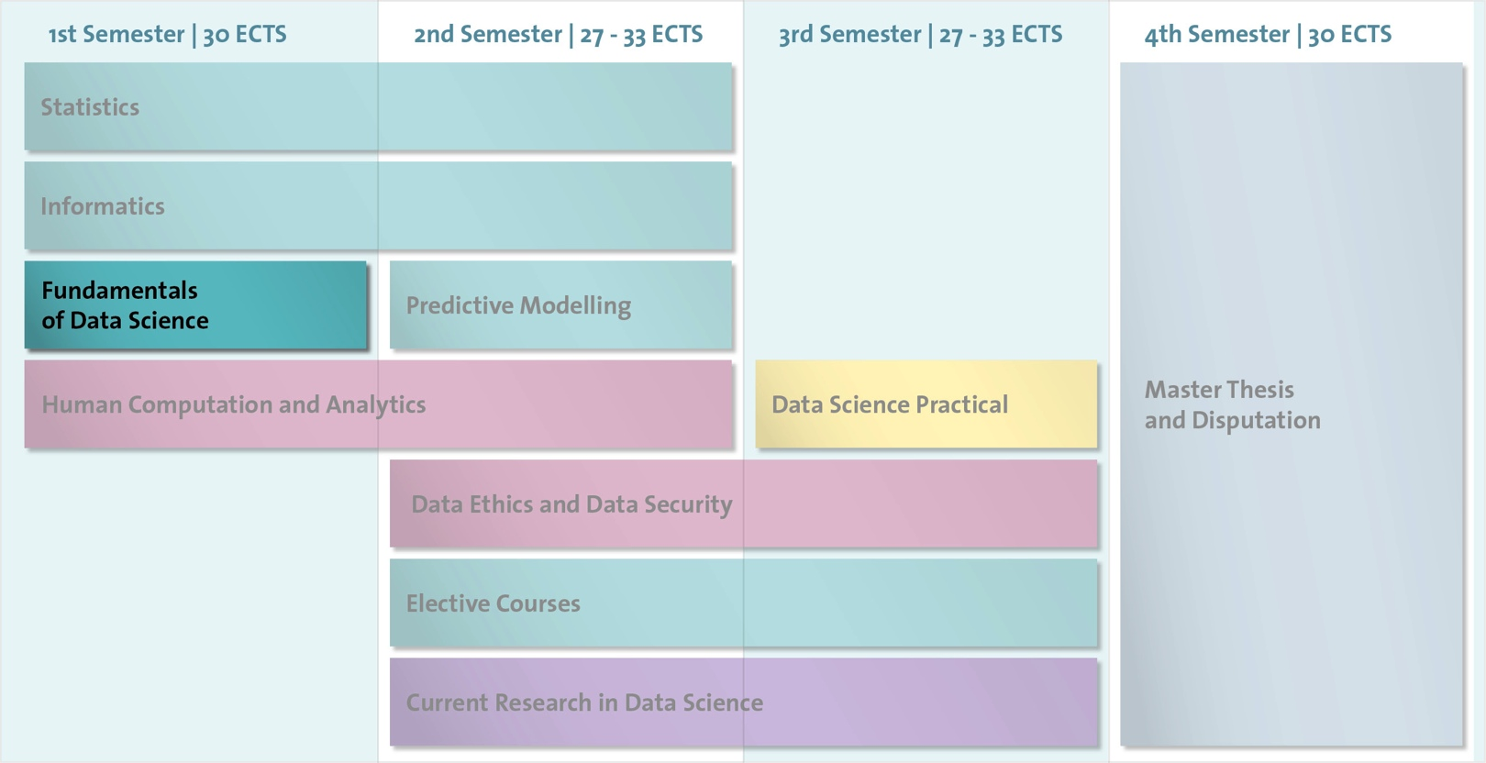

Slide 14
Fundamentals of Data Science
(Individual Module)
Heterogeneous level of expertise of incoming students
Personalised assignment to courses in statistics and informatics to suit individual student’s needs
Result: homogeneous level of expertise after first semester

Slide 15
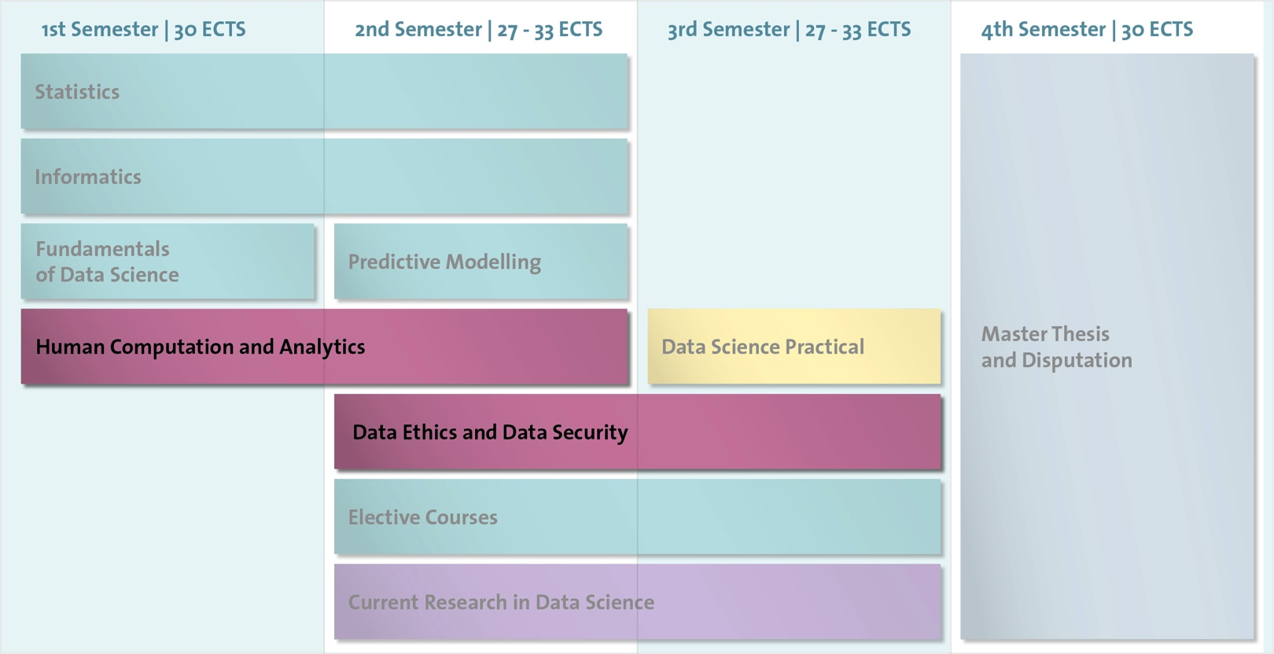

Slide 16
Human Computation and Analytics
Includes a practical in which students will implement their own concepts for HC/VA systems
in the form of a working prototype
Data Ethics and Data Security
Methodological questions of data anonymisation
Lecture series with (invited) talks on technical, ethical, and legal aspects of data security

Slide 17
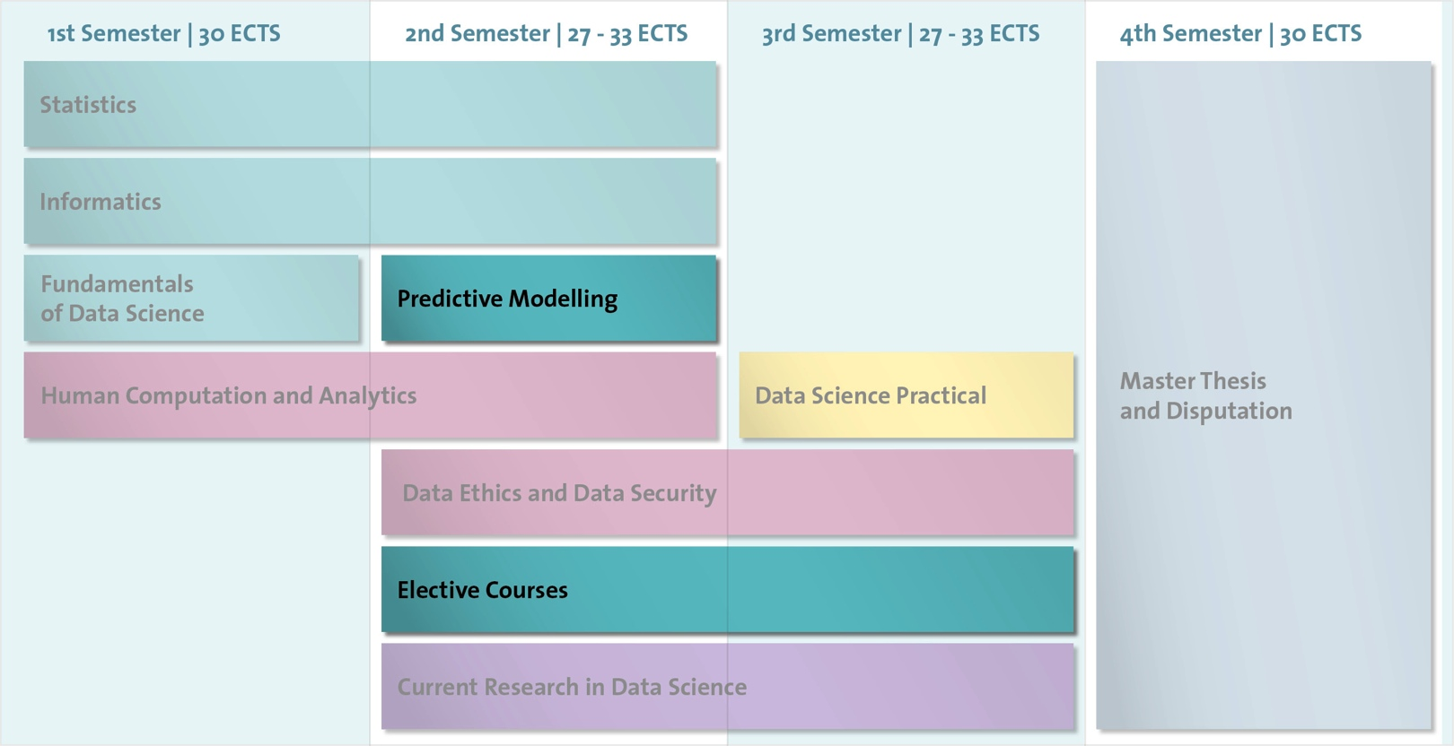

Slide 18
Predictive Modelling
Theory and algorithms of supervised statistical learning
Elective Modules
Regular master courses from statistics, informatics, and computer linguistics
Selected master courses from other departments
Selected master courses from partner universities, e.g. image processing at TUM

Slide 19
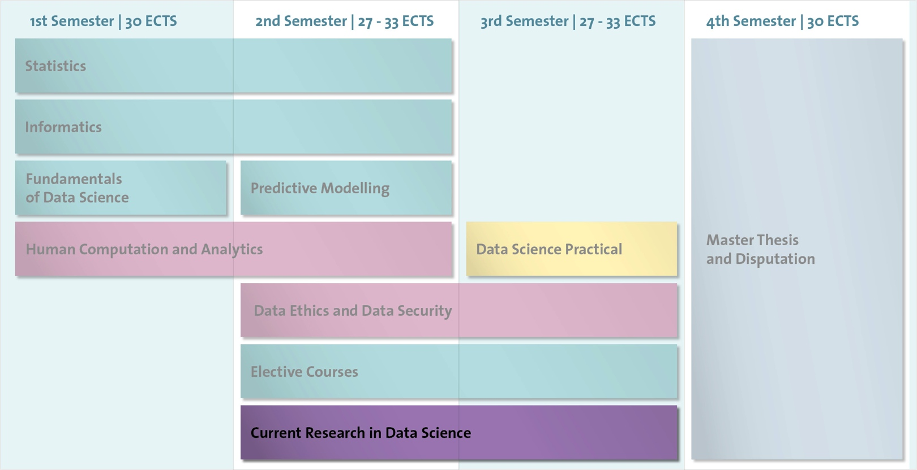

Slide 20

Current Research in Data Science
Data Science Summer School
  data security and data confidentiality, ethical
  and legal topics
Data Science Focused Tutorials
  biosciences, e-commerce, networks etc
Data Science meets Data Practice
  lecture series with experts from industry and business
Field trips

Slide 21
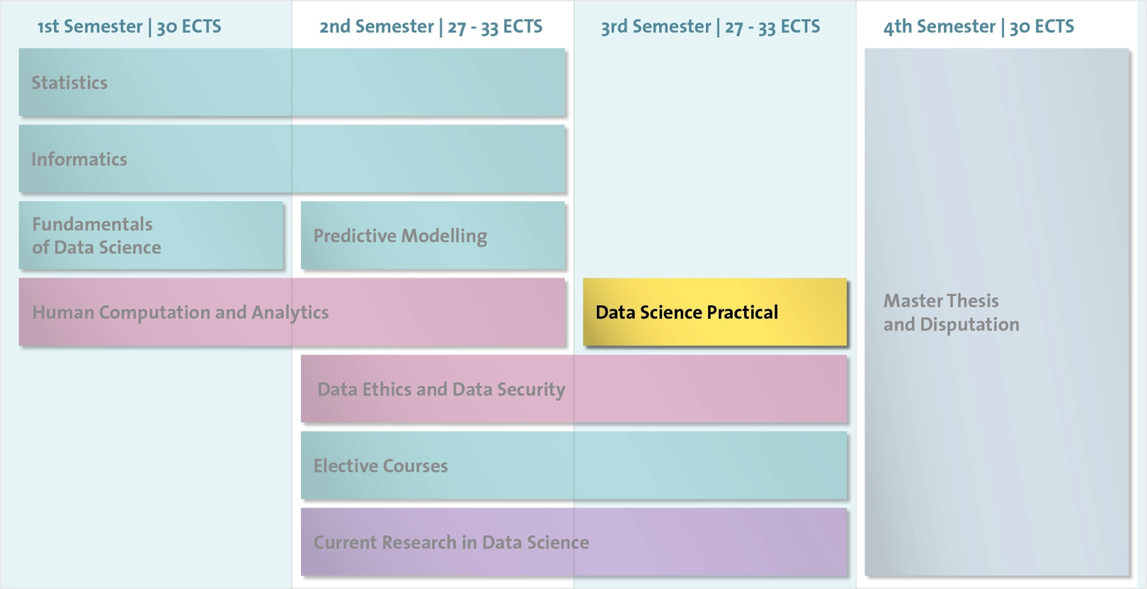

Slide 22
Data Science Practical
Supervised practical in the 3rd semester, ca. 2-3 months
Students work on practical problems in the field of
Data Science
Close cooperation with industry and business partners
Focus on communicating results and findings to the clients

Slide 23
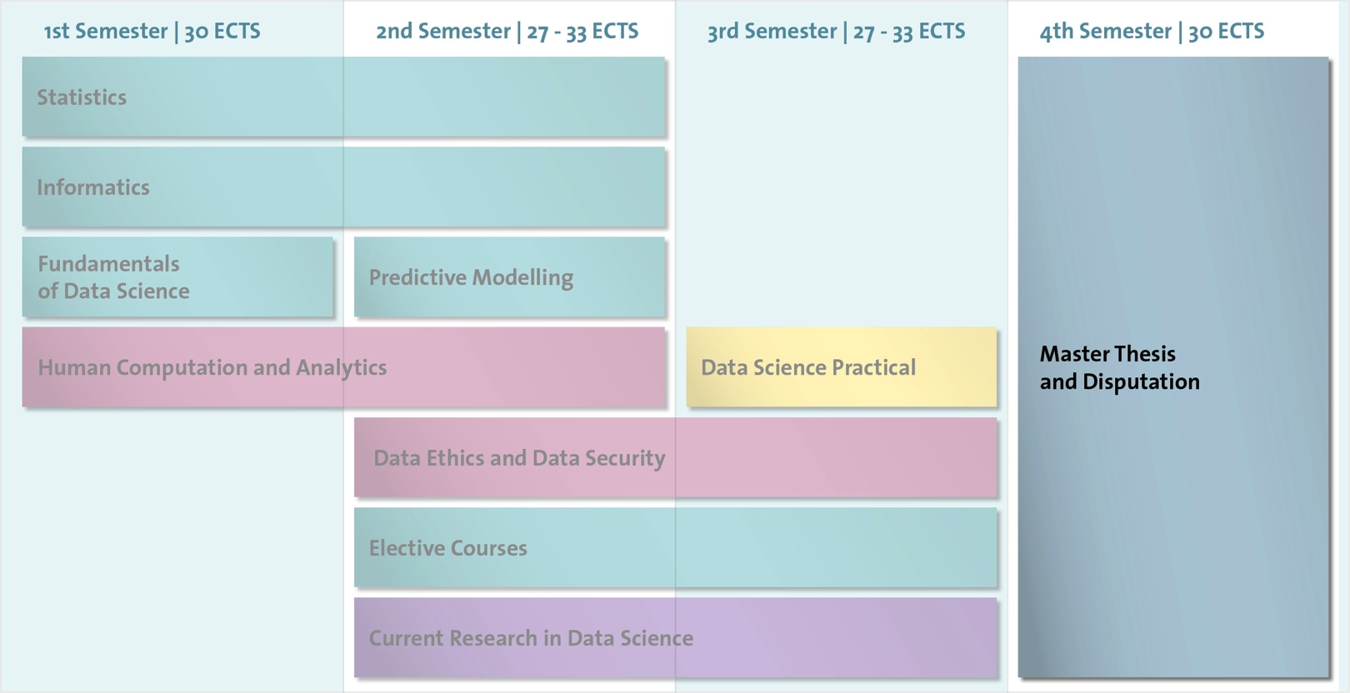

Slide 24
Master Thesis and Disputation
Thesis may be either research-oriented or stimulated through a practical problem
After submission and assessment
→ oral defence

Slide 26
Curriculum – Summary
Modules exclusively for Data Science students
Individual Modules tailored to suit individual student’s needs
Courses on data ethics, data confidentiality, and data security
Close cooperation with partners in industry and business (DS Practicals, Lecture series, …)
Tutorials, Workshops, Summer Schools

Slide 27









Data Science@LMU Activities and Cooperations
MSc Data Science
Data Science Professional Certificate Program
German Data Science Days
Data Science Lab
Munich Center for Machine Learning
MUDS
Konrad Zuse School of Excellence in Reliable AI
AIM@LMU
Zentrum Digitalisierung Bayern

Slide 28








Local Academic Ties
Universities
  TU München
  Universität Augsburg
  Universität Mannheim
Research Institutes
  Leibniz-Rechenzentrum
  HelmholtzZentrum München
  IAB Nürnberg
  MPI for Innovation and Competition
  Bayerisches Finanz Zentrum

Slide 29











Close Cooperation with Industry and Business

Slide 30
Requirements
and Application

Slide 31
Requirements for Application (1/2)
Students with excellent knowledge in informatics and statistics
Students not interested in specialising in either statistics or informatics
Bachelor of Science (or equivalent) in Statistics or Informatics or related disciplines
→ at least 180 ECTS (or equivalent)
Proficiency in English

Slide 32
Requirements for Application (2/2)
Statistical Science and Data-Based Modelling
  statistics, data mining, probability theory, and machine learning
  at least 30 ECTS or equivalent
Computer Science and Computational Methods
  data structures and algorithms, database systems, programming principles and practice, software engineering
  at least 30 ECTS or equivalent

Slide 33
Application – Step 1: Online Application
Step 1 is successful if
  application is submitted before the deadline
  application documents are complete
  all requirements are fulfilled
  essay is approved by committee
  → Invitation to interview (Step 2)

Slide 34
Application – Step 2: Interview
30 minutes, in English
In person or by video-chat
Two professors
Discussion topics see website
→ Assessment of specialised knowledge, mode of
  expression, conclusiveness of arguments

Slide 35
Application Process – Dates and Deadlines
Step 1: Online application
  mid-April – 1 June 2023
Step 2: Interview
  end of June 2023
  Letters of acceptance are sent out by email
  in mid-July 2023

Slide 36
General information (for international students) on LMU Munich / Munich
…on the LMU homepage, e.g.
Costs/scholarships
  https://www.en.uni-muenchen.de/students/
  int_student_guide/before_you_arrive/budgeting/index.html
Housing
  https://www.en.uni-muenchen.de/students/exchange/
  incomings/austausch_engl/living/accommodation/index.html

Slide 37
www.datascience-munich.de

